Slide 1



Slide 2
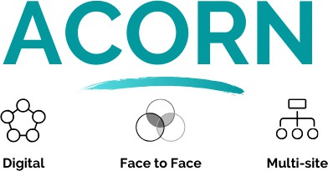

Slide 3

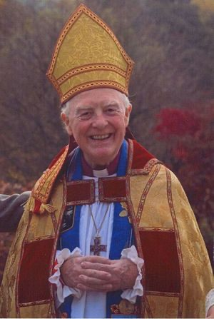
Acorn Christian Healing Foundation
Rt Rev Morris Maddocks
Bishop of Selby 1972-1983
Invitation from ++Canterbury and ++York - 1st Healing Advisor to the C of E
Began Acorn in 1983
To train and equip the Church in the Healing Ministry of Christ
“Healing is Jesus Christ meeting you at
your point of need”

Slide 4

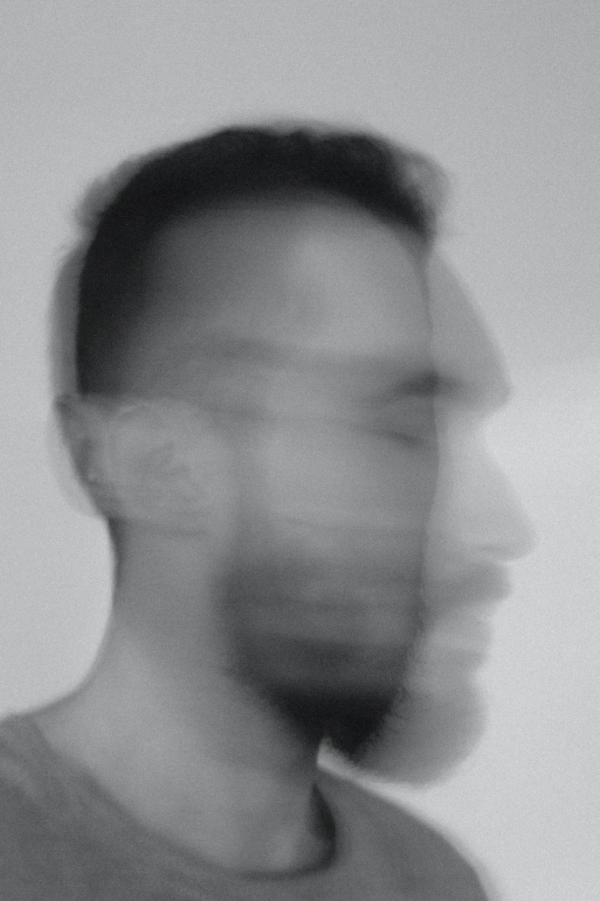
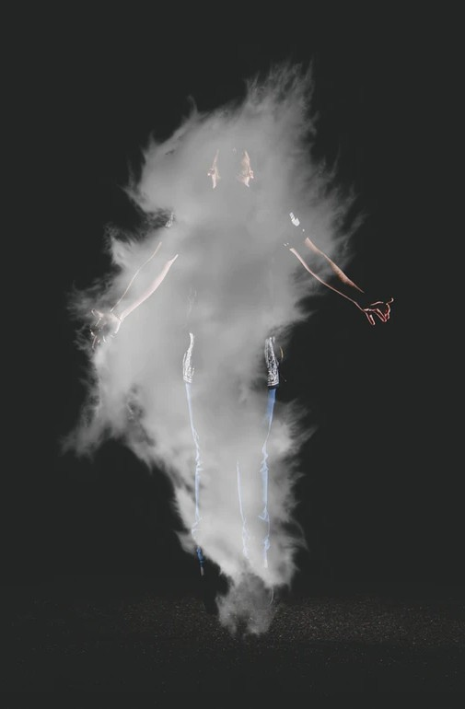
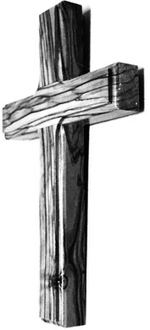
Acorn Christian Healing Foundation

Slide 5




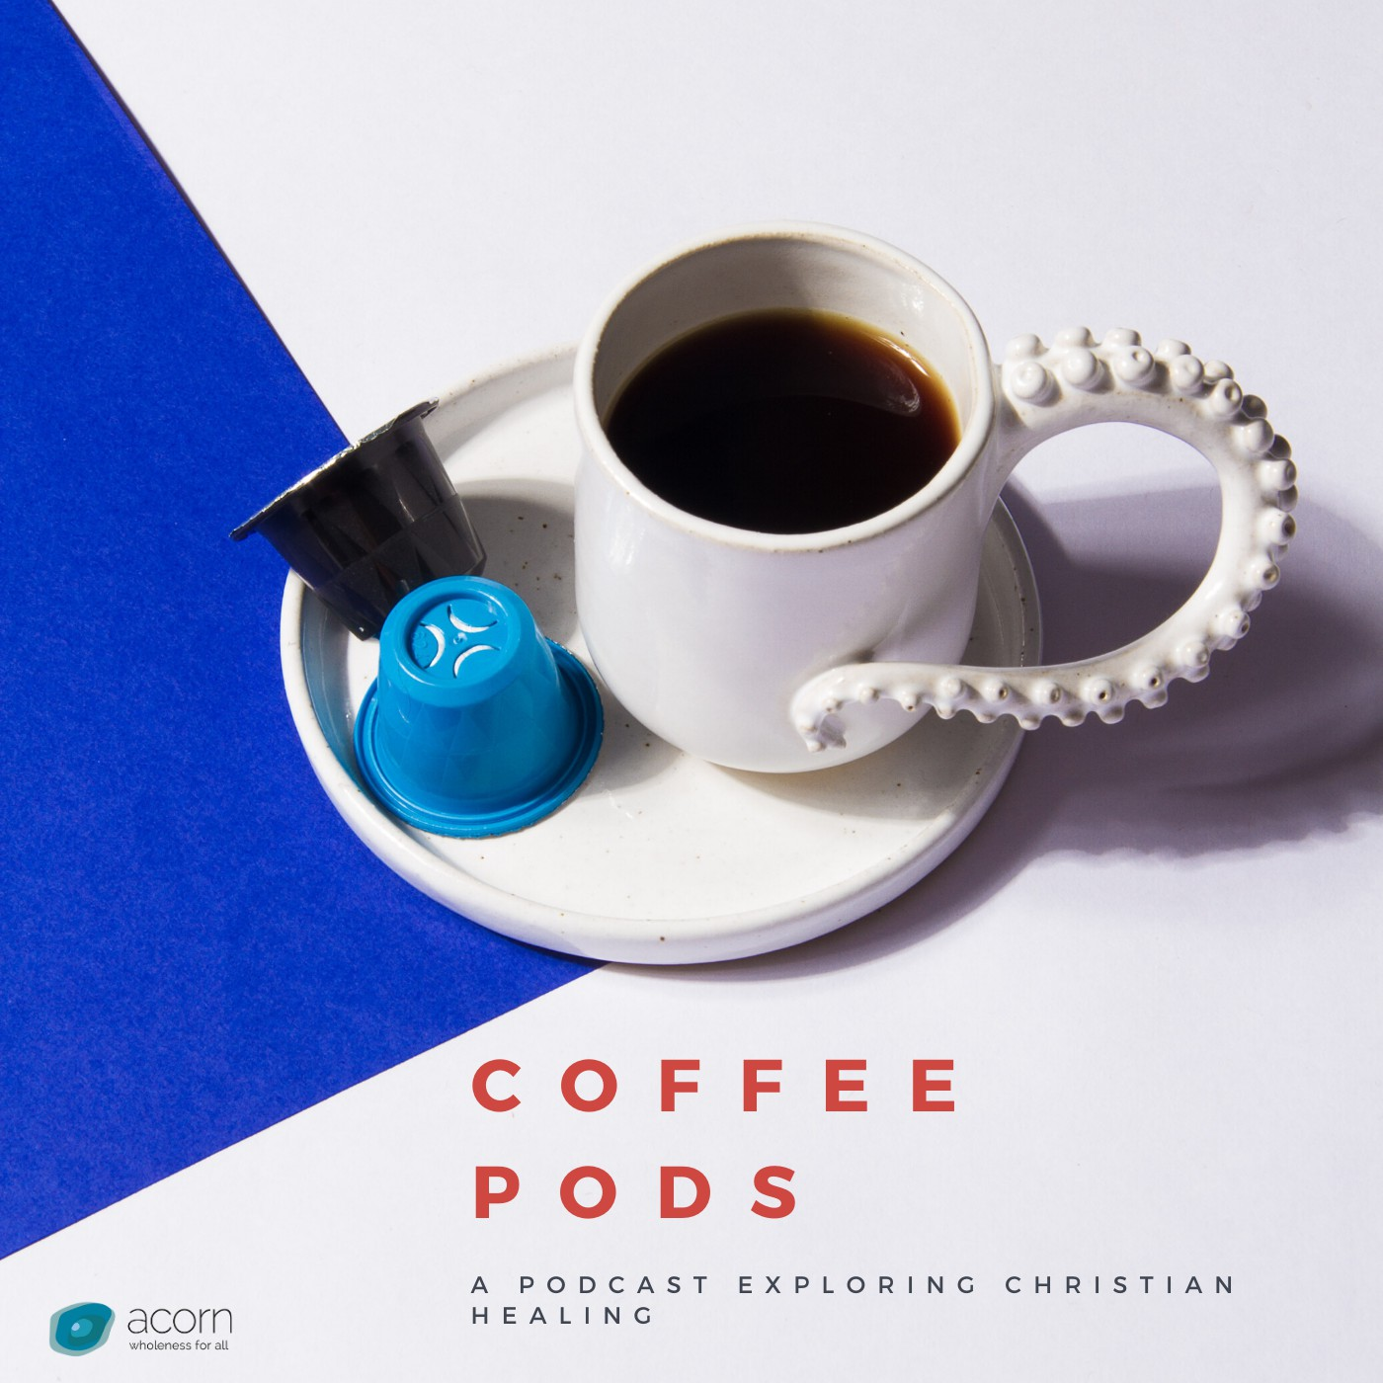

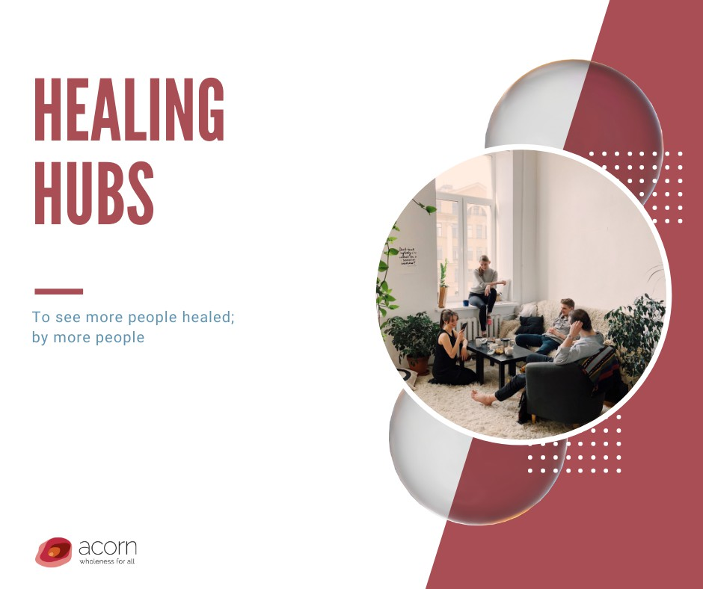

Slide 6
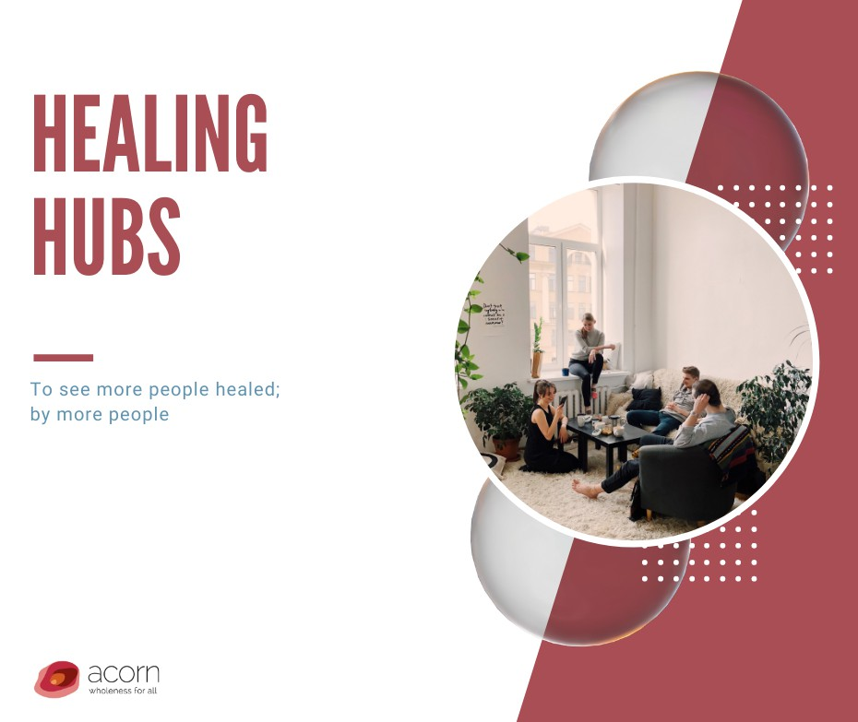
Acorn Christian Healing Foundation

Slide 7
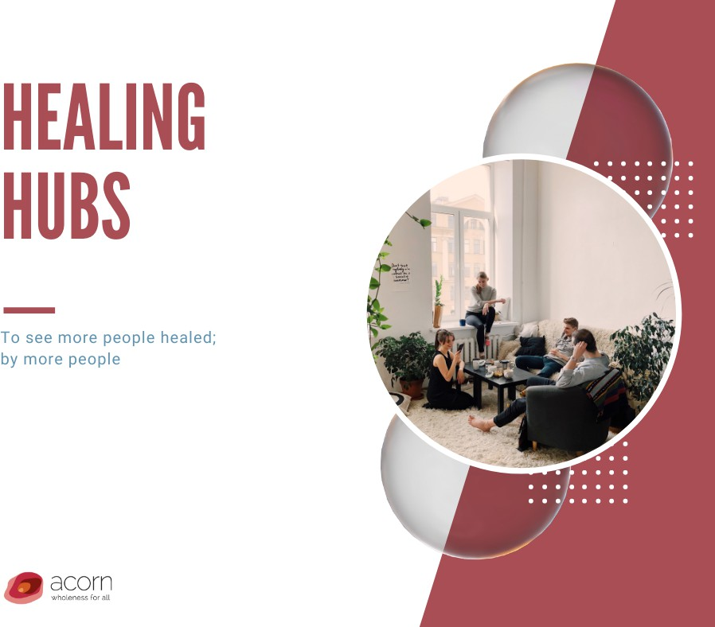
Acorn Healing Hubs
Beginning with a team of 6
Locally led : Nationally resourced
A ‘service’ to local church : where it is needed.
Initial training : Acorn Healing Academy 12 monthly - online
  1st Saturday am 3 hrs
Ongoing training : support : oversight : supervision
Monthly National Coordinators meeting - online
Monthly local Hub meetings - Prayer and planning

Slide 8
Acorn Healing Hubs
Bordon (Hants)
Gosport
Digital (online)
Alford (East Lincs)
Guildford (Cathedral)
Carnmoney Belfast
Antrim Belfast
Dorchester
Grantham (Lincs)
Horncastle (Lincs)
Leicester
Essex
Basingstoke
Isle of Man
Surrey
Kent
Carlisle
Liverpool
South Wales

Slide 9

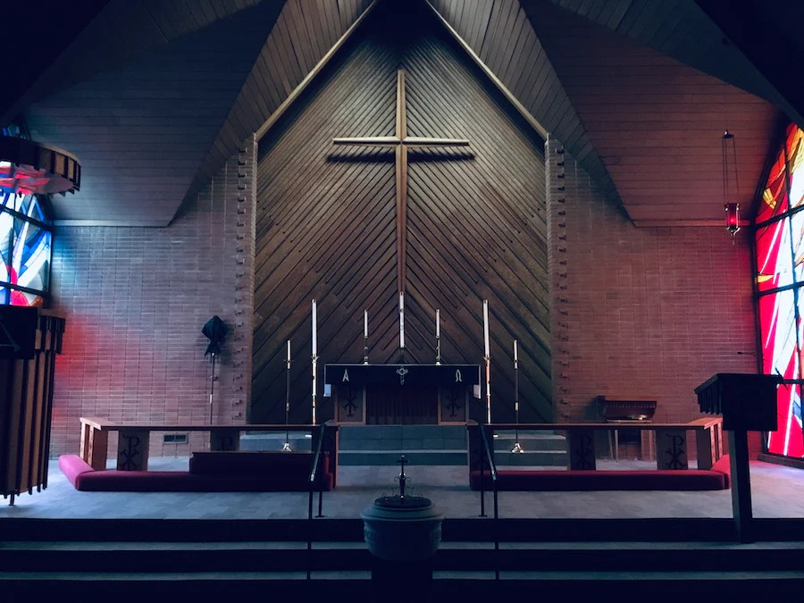
Acorn Healing Hubs: multi-church and multi-genre

Slide 10

Session 2 : 4 paradigms

Slide 11
Healing and Mission
Your view of healing is predicated on 4 essential paradigms
What you believe about the nature of God
What you believe is in the ‘great commission’
What you believe about prayer
What you believe about faith

Slide 12
FOUR PARADIGMS
One
What you believe about the nature of God and his relationship to reality
  Good God?
  Interventionist?

Slide 13
FOUR PARADIGMS
Two
What you believe the Great Commission contains - why are you here?
  Words
  Works
  Wonders

Slide 14
FOUR PARADIGMS
Three
What you believe about prayer, and how it impacts reality
  Why pray?
  What happens when I pray?
  What changes when I pray?
  How does prayer impact God

Slide 15
FOUR PARADIGMS
Four
An understanding of faith
Nature of faith
  Faith as trust / faith as certainty
  God must – and does – act consistent with his word and his character : Ps 138:2
    “Your faith (in me) has made you whole”

Slide 16
FOUR PARADIGMS
Whose faith? – 5 arenas in NT
  Jesus
  Sick person
  A third party: friend or family
  The person praying
  The community

Slide 17
FOUR PARADIGMS
Faith perceives a different reality
  A Kingdom of God orientation
  Moving people or situations to how God would want things
  Taking a risk – outcomes
  Following the ‘flow of love’

Slide 18

FOUNDED ON 3 STATEMENTS
Conversation:
The Father wants me well and ‘whole’
Jesus did everything on the Cross to make that possible
The Holy Spirit is present and active to put it into effect
What do you think?

Slide 19
Conversation:
The church is fine with funerals and comfortable with counselling - but miracles leave us nervous.
Why is this and how do we overcome it?

